Slide 1
Shortest Path Algorithms

Slide 2
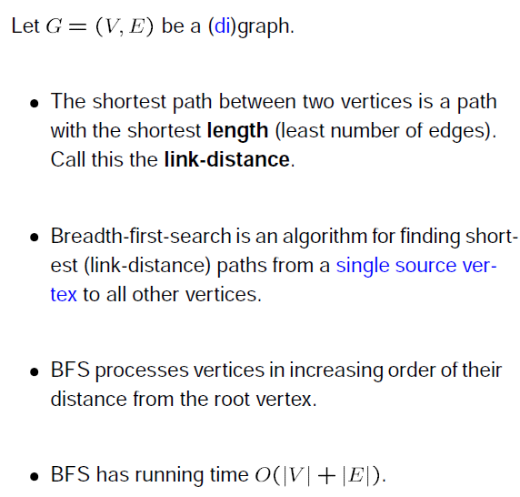
Shortest Path for Non-Weighted Graph

Slide 3
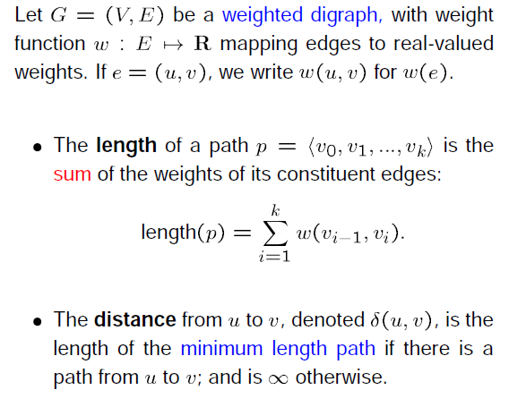
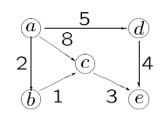

Shortest Path for Weighted Graph

Slide 4
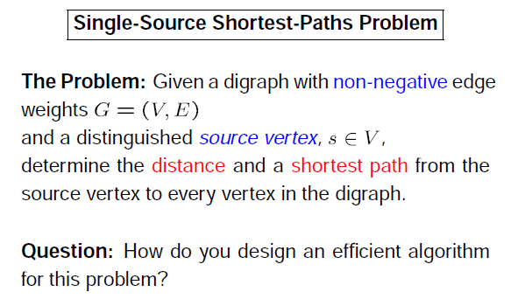

Slide 5
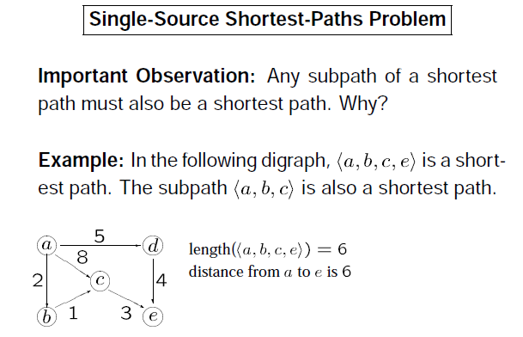

Slide 6
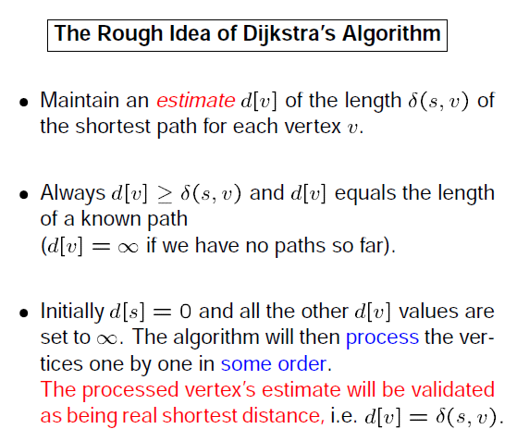

Slide 7
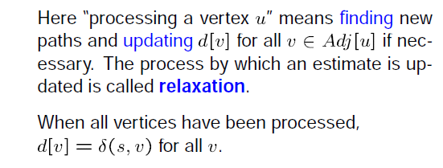
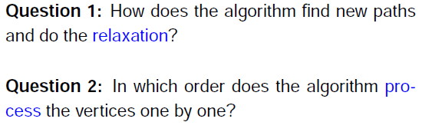

Slide 8
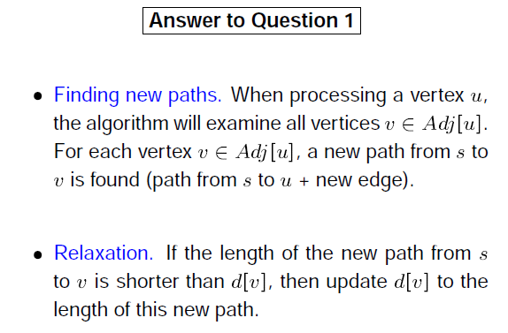

Slide 9
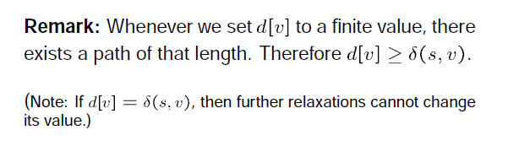

Slide 10
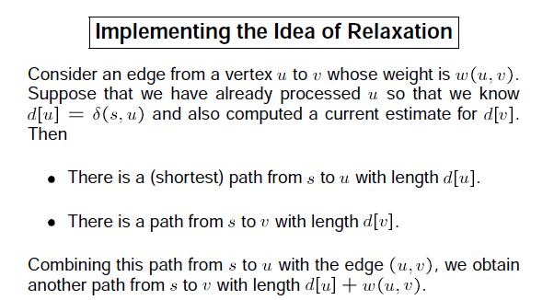

Slide 11
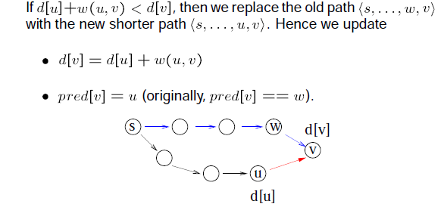

Slide 12
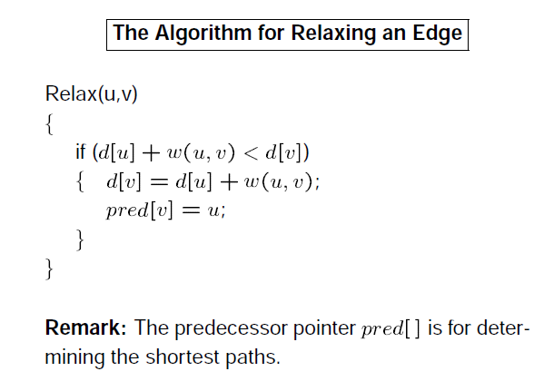

Slide 13
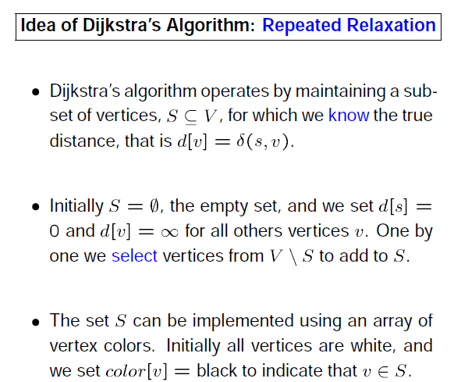

Slide 14
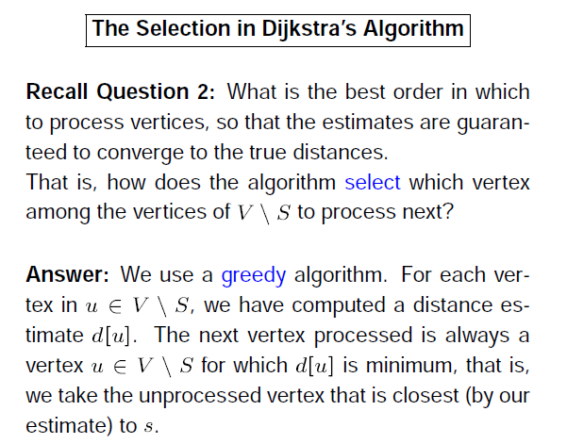

Slide 15
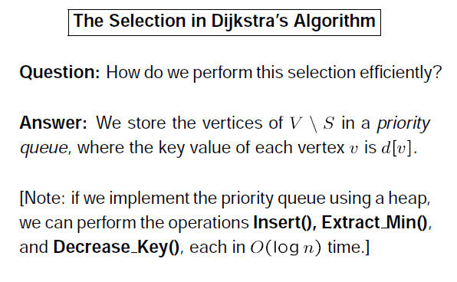

Slide 16
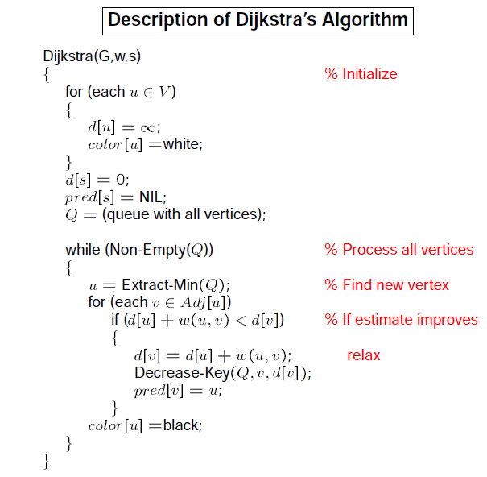

Slide 17
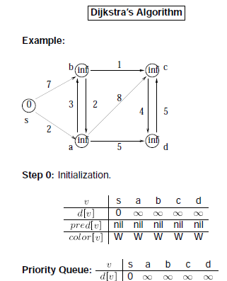

Slide 18

Graph Property
Triangular Inequality:
s
u
v

Slide 19
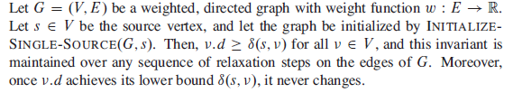
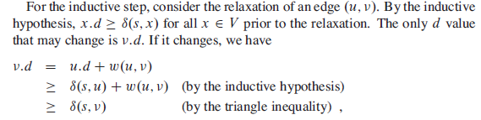
Upper Bound Property

Slide 20
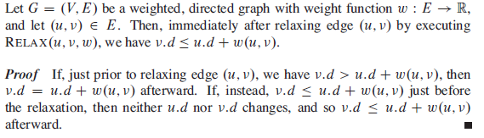

Slide 21



Convergence Property

Slide 22

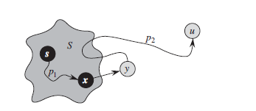
Correctness of Dijkstra’s Algorithm
At the start of each iteration of the while loop , v.d = δ(s,v) for each vertex .

Slide 23
At the beginning when only s S this is true as d.s =0 (as per initialization) which is the shortest path distance of δ(s,s).
Assume that u is the first node for which it is violating.
So, when u is added S is non empty as s is already included
It can be also argued that there is a shortest path between s and u otherwise u.d and δ(s,u) both would be equal to ∝.
Let us consider that iteration in which node u is added to set S
Assume that in that path x is the last node that belongs to S and y is the first node that belongs to the V-S

Slide 24

We can decompose the path like
where there might not be any edge in either
p1 or p2 or in both p1 and p2.
For x x.d=δ(s,x) as we have assumed that it is first violating for u
From the convergence property y.d=δ(s,y)
As y appears before u then δ(s,y)<δ(s,u)

Slide 25
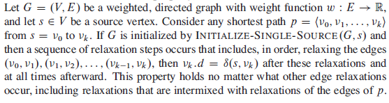
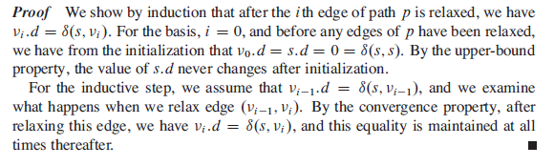
Path Relaxation Property

Slide 26
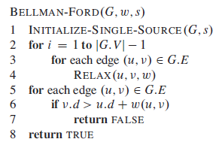
Bellman Ford Algorithm

Slide 27
Bellman-Ford algorithm
0
∞
10
S
A
Iteration: 0
8
1
∞
∞
G
-4
B
2
1
1
-2
C
∞
F
∞
-1
3
E
D
-1
∞
∞

Slide 28
Bellman-Ford algorithm
0
10
10
S
A
Iteration: 1
8
1
∞
8
G
-4
B
2
1
1
-2
C
∞
F
∞
-1
3
E
D
-1
∞
∞

Slide 29
Bellman-Ford algorithm
0
10
10
S
A
Iteration: 2
8
1
∞
8
G
-4
B
2
1
1
-2
C
∞
F
9
-1
3
E
D
-1
12
∞

Slide 30
Bellman-Ford algorithm
0
5
10
S
A
Iteration: 3
8
1
10
8
G
-4
B
A has the correct distance and path
2
1
1
-2
C
∞
F
9
-1
3
E
D
-1
8
∞

Slide 31
Bellman-Ford algorithm
0
5
10
S
A
Iteration: 4
8
1
6
8
G
-4
B
2
1
1
-2
C
11
F
9
-1
3
E
D
-1
7
∞

Slide 32
Bellman-Ford algorithm
0
5
10
S
A
Iteration: 5
8
1
5
8
G
-4
B
B has the correct distance and path
2
1
1
-2
C
7
F
9
-1
3
E
D
-1
7
14

Slide 33
Bellman-Ford algorithm
0
5
10
S
A
Iteration: 6
8
1
5
8
G
-4
B
2
1
1
-2
C
6
F
9
-1
3
E
D
-1
7
10

Slide 34
Bellman-Ford algorithm
0
5
10
S
A
Iteration: 7
8
1
5
8
G
-4
B
D (and all other nodes) have the correct distance and path
2
1
1
-2
C
6
F
9
-1
3
E
D
-1
7
9

Slide 35
Correctness of Bellman-Ford
Loop invariant: After iteration i, all vertices with shortest paths from s of length i edges or less have correct distances

Slide 36
All Pair Shortest path

Slide 37
All-Pairs Shortest Path Problem
Suppose we are given a directed graph G=(V,E) and a weight function w: E->R.
We assume that G does not contain cycles of weight 0 or less.
The All-Pairs Shortest Path Problem asks to find the length of the shortest path between any pair of vertices in G.

Slide 38
Quick Solutions
If the weight function is nonnegative for all edges, then we can use Dijkstra’s single source shortest path algorithm for all vertices to solve the problem.
This yields an O(n³) algorithm on graphs with n vertices (on dense graphs and with a simple implementation).

Slide 39
Quick Solution
For arbitrary weight functions, we can use the Bellman-Ford algorithm applied to all vertices. This yields an O(n⁴) algorithm for graphs with n vertices.

Slide 40
Floyd-Warshall
We will now investigate a dynamic programming solution that solved the problem in O(n³) time for a graph with n vertices.
This algorithm is known as the Floyd-Warshall algorithm, but it was apparently described earlier by Roy.

Slide 41
Representation of the Input
We assume that the input is represented by a weight matrix W= (w_{ij})_{i,j in E} that is defined by
w_{ij}= 0 if i=j
w_{ij}= w(i,j) if i≠j and (i,j) in E
w_{ij}= ∞ if i≠j and (i,j) not in E

Slide 42
Format of the Output
If the graph has n vertices, we return a distance matrix (d_{ij}), where d_{ij} the length of the path from i to j.

Slide 43
Intermediate Vertices
Without loss of generality, we will assume that V={1,2,…,n}, i.e., that the vertices of the graph are numbered from 1 to n.
Given a path p=(v₁, v₂,…, v_{m}) in the graph, we will call the vertices v_{k} with index k in {2,…,m-1} the intermediate vertices of p.

Slide 44
Remark 2
Consider a shortest path p from i to j such that the intermediate vertices are from the set {1,…,k}.
If the vertex k is not an intermediate vertex on p, then d_{ij}^{(k)} = d_{ij}^{(k-1)}
If the vertex k is an intermediate vertex on p, then d_{ij}^{(k)} = d_{ik}^{(k-1)} + d_{kj}^{(k-1)}
Interestingly, in either case, the subpaths contain merely nodes from {1,…,k-1}.

Slide 45
Remark 2
Therefore, we can conclude that
d_{ij}^{(k)} = min{d_{ij}^{(k-1)} , d_{ik}^{(k-1)} + d_{kj}^{(k-1)}}

Slide 46
Recursive Formulation
If we do not use intermediate nodes, i.e., when k=0, then
d_{ij}⁽⁰⁾ = w_{ij}
If k>0, then
d_{ij}^{(k)} = min{d_{ij}^{(k-1)} , d_{ik}^{(k-1)} + d_{kj}^{(k-1)}}

Slide 47
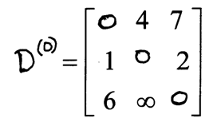
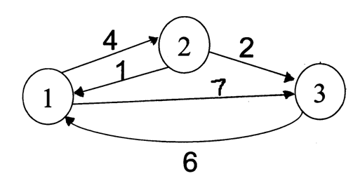
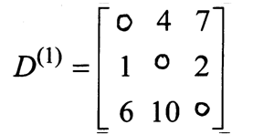
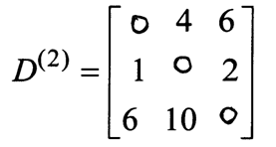
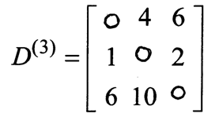
Floyd Warshall Algorithm - Example
Original weights.
Consider Vertex 1:
D(3,2) = D(3,1) + D(1,2)
Consider Vertex 2:
D(1,3) = D(1,2) + D(2,3)
Consider Vertex 3:
Nothing changes.

Slide 48
The Floyd-Warshall Algorithm
Floyd-Warshall(W)
n = # of rows of W;
D⁽⁰⁾ = W;
for k = 1 to n
for i = 1 to n
for j = 1 to n
d_{ij}^{(k)} = min{d_{ij}^{(k-1)} , d_{ik}^{(k-1)} + d_{kj}^{(k-1)}};
return D^{(n)};

Slide 49
Floyd Warshall – Path Reconstruction
The path matrix will store the last vertex visited on the path from i to j.
So path[i][j] = k means that in the shortest path from vertex i to vertex j, the LAST vertex on that path before you get to vertex j is k.
Based on this definition, we must initialize the path matrix as follows:
path[i][j] = i if i!=j and there exists an edge from i to j
= NIL otherwise
The reasoning is as follows:
If you want to reconstruct the path at this point of the algorithm when you aren’t allowed to visit intermediate vertices, the previous vertex visited MUST be the source vertex i.
NIL is used to indicate the absence of a path.

Slide 50
Floyd Warshall – Path Reconstruction
Before you run Floyd Warshall, you initialize your distance matrix D and path matrix P to indicate the use of no intermediate vertices.
(Thus, you are only allowed to traverse direct paths between vertices.)
Then, at each step of Floyd Warshall, you essentially find out whether or not using vertex k as intermediate vertex will improve an estimate between the distances between vertex i and vertex j.

Slide 51
Floyd Warshall – Path Reconstruction
If it does improve the estimate here’s what you need to record:
record the new shortest path weight between i and j
record the fact that the shortest path between i and j goes through k
We want to store the last vertex from the shortest path from vertex k to vertex j. This will NOT necessarily be k, but rather, it will be path[k][j].
This gives us the following update to our algorithm:
if (D[i][k]+D[k][j] < D[i][j]) { // Update is necessary to use k as intermediate vertex
D[i][j] = D[i][k]+D[k][j];
path[i][j] = path[k][j];
}

Slide 52
Path Reconstruction
Now, the once this path matrix is computed, we have all the information necessary to reconstruct the path.
Consider the following path matrix (indexed from 1 to 5 instead of 0 to 4):
Reconstruct the path from vertex1 to vertex 2:
First look at path[1][2] = 3. This signifies that on the path from 1 to 2, 3 is the last vertex visited before 2.
Thus, the path is now, 1…3->2.
Now, look at path[1][3], this stores a 4. Thus, we find the last vertex visited on the path from 1 to 3 is 4.
So, our path now looks like 1…4->3->2. So, we must now look at path[1][4]. This stores a 5,
thus, we know our path is 1…5->4->3->2. When we finally look at path[1][5], we find 1,
which means our path really is 1->5->4->3->2.
NIL | 3 | 4 | 5 | 1
4 | NIL | 4 | 2 | 1
4 | 3 | NIL | 2 | 1
4 | 3 | 4 | NIL | 1
4 | 3 | 4 | 5 | NIL

Slide 53

Johnson’s algorithm for sparse graphs
If all edge weights w in a graph G = (V,E) are nonnegative then we can find shortest paths between all pairs of vertices by running Dijkstra’s algorithm once from each vertex.
If all edges are not non-negative, then we have to do some reweighting so that all edge weights become non-negative
w→

Slide 54

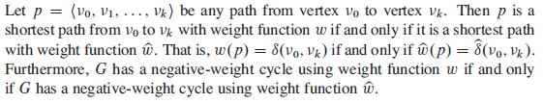
Preserving shortest paths by reweighting
Reweighting does not change shortest paths

Slide 55


Slide 56
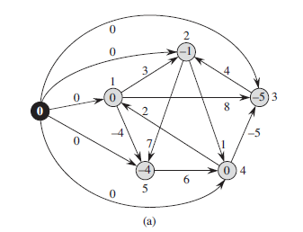
Producing nonnegative weights by reweighting
A new vertex is inserted and all existing vertices are connected from new vertex using edge with weight 0 and then bellman ford is executed using new node as source

Slide 57
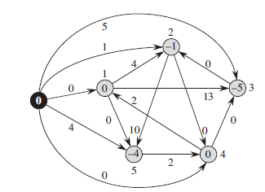

Slide 58
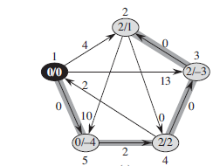

Slide 59
